Slide 1
Adaboosting classifier
By: Morgan Hardin

Slide 2
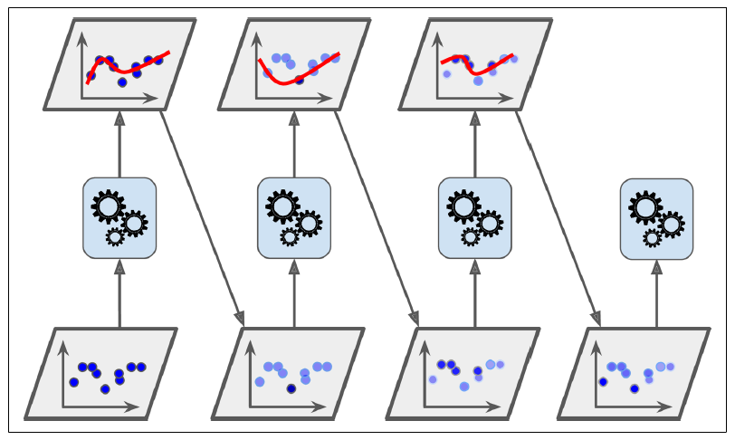
Adaboost Definition
Ensemble technique
Method of training various learners and bringing them together to improve the accuracy score
Weak learners are combined to create a strong learner
Decision stumps
Tree with one split (root) and 2 terminal nodes (leaves)
Misclassified instances are given an increased weighted and the model is trained again with updated weights

Slide 3
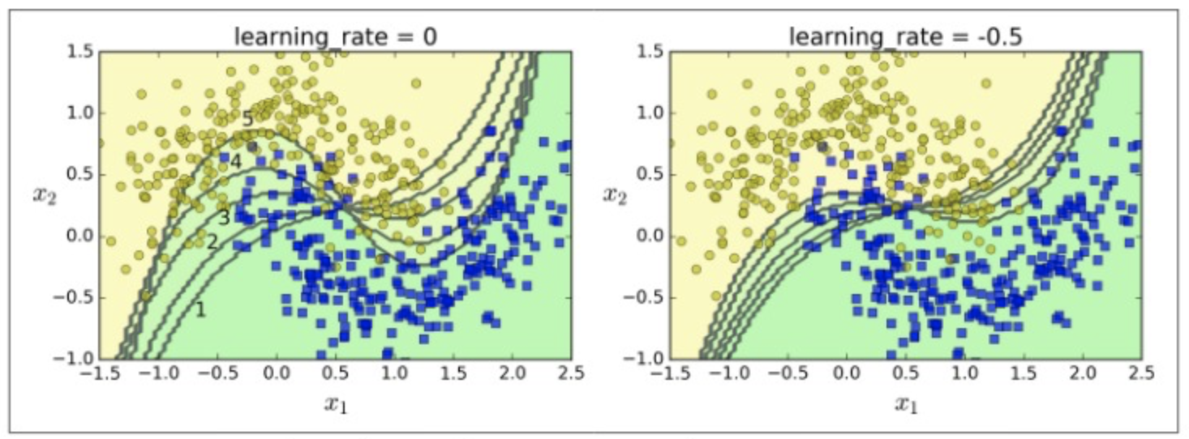
Applications of Adaboosting
Adaboost can be used to solve:
Classification problems
Predicting if a person has a disease like cancer, diabetes, etc.
Predicting a person’s credit score
Predicting if an object is of a certain class / group
Type of flower
Spam or not spam

Slide 4
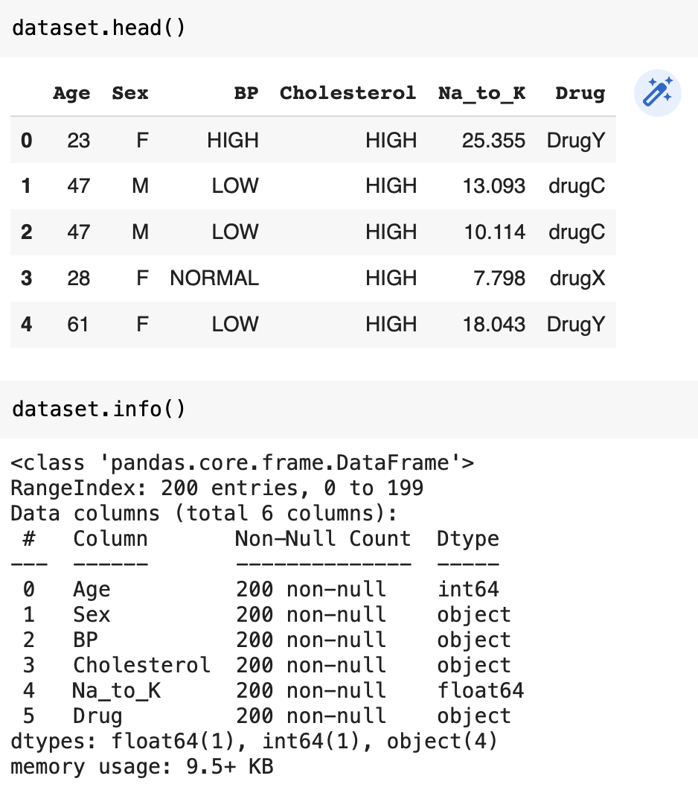
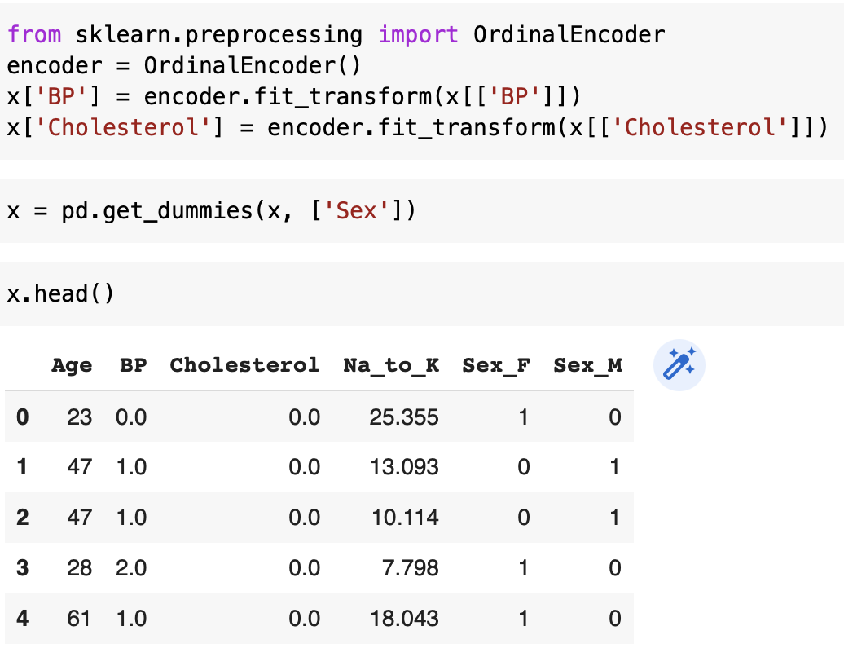
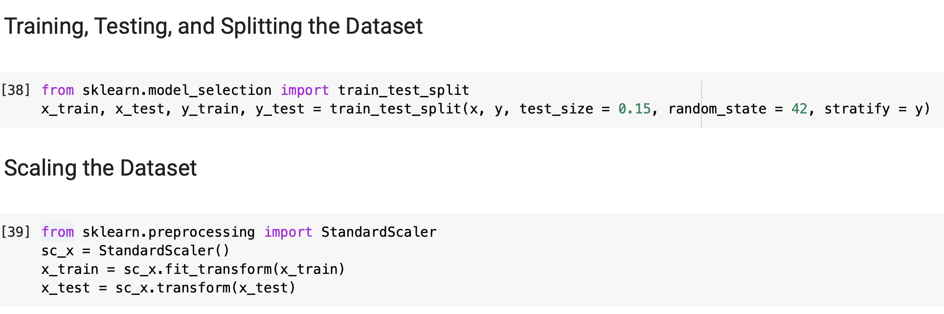
Example of Adaboosting Classifier
Drug dataset where ‘BP’, ‘Cholesterol’, and ‘Sex’ are encoded to be numerical values
Scaled x training and test sets since it’s a classification problem and it makes the data more accurate since ‘Age’ and ‘Na_to_K’ are much larger than ‘BP’, ‘Cholesterol’, and “Sex_M’ / Sex_F’
Stratified y since outcome of ‘Drug’ was not evenly distributed

Slide 5
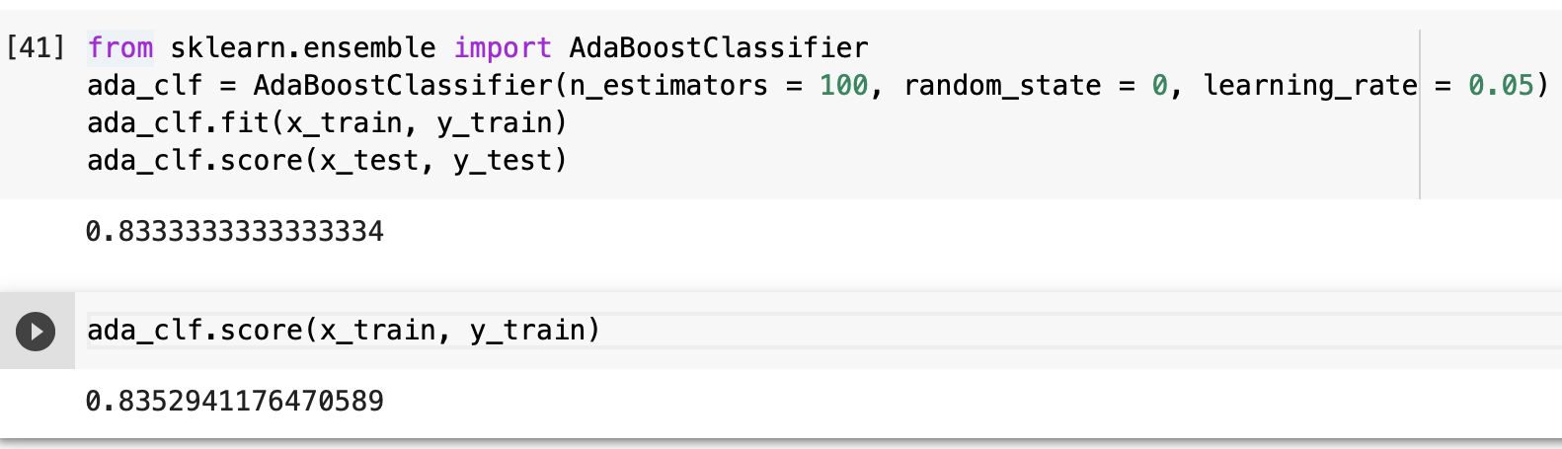
Example of Adaboosting Classifier
n_estimators: number of trees for the classifier
random_state: keeps score from changing with each execution
learning_rate: controls the speed of which the model will learn
Model is not overfitted with accuracy scores of 83% (test) and 84% (training)

